Slide 1
Mitigating Bird Strikes in Aviation

Slide 2
Project Objective
To conduct an exploratory data analysis using Tableau's visualization capabilities on a comprehensive flight bird strike dataset. The goal is to identify patterns and key risk factors contributing to bird strikes, and extract actionable insights. This analysis focuses on enhancing safety, ensuring regulatory compliance, improving operational efficiency, reducing costs, preventing injuries, and supporting wildlife conservation. Findings will be communicated through a storytelling approach using insightful visualizations.

Slide 3
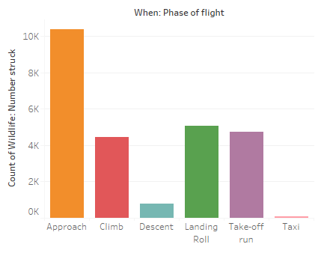
Count of Wildlife: Number struck for each When: Phase of flight. Color shows details about When: Phase of flight. The data is filtered on Wildlife: Species, which keeps 348 of 348 members. The view is filtered on When: Phase of flight, which excludes Null and Parked.

Slide 4
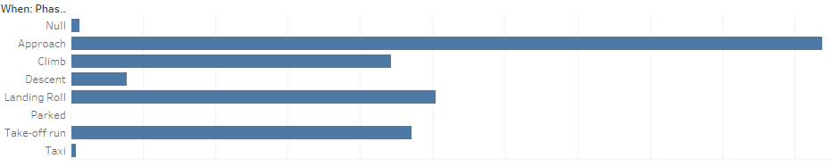
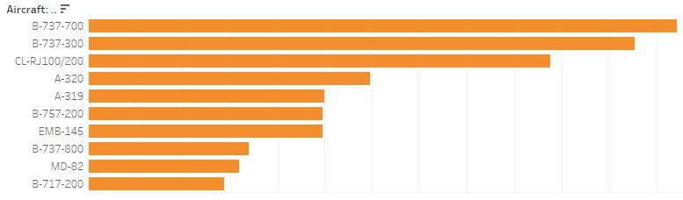
The most common wildlife species involved in bird strikes can be identified, along with the flight phases during which they occur most frequently. Typically, larger birds like geese might be more common during takeoff and landing phases, where they are often present near airports. Smaller birds might be frequent during cruise or climb phases. This analysis helps pinpoint high-risk species and the critical phases of flight where interventions can be targeted
The view is filtered on Aircraft: Make/Model, which keeps 10 of 351 members.

Slide 5
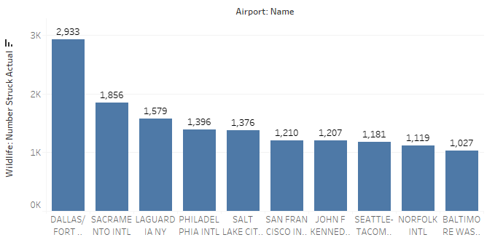
The airport at the top of the chart is the one with the highest number of bird strikes, indicating a potential area of concern that may require focused mitigation efforts.

Slide 6
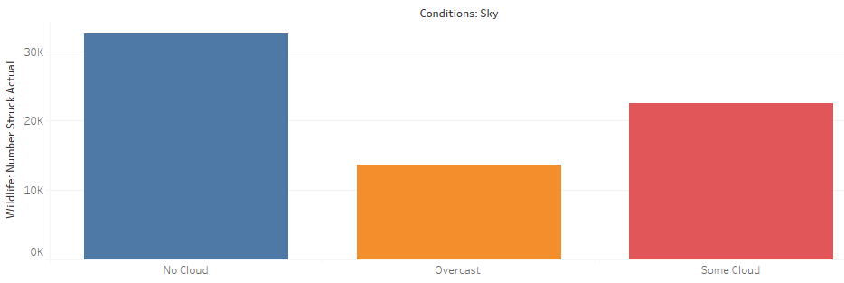
This analysis will show which sky conditions (e.g., clear, cloudy) are most common during bird strikes, helping to identify environmental factors that might influence the likelihood of such incidents.
Flight Date Year for each Wildlife: Number struck. Color shows details about Origin State. The marks are labeled by Flight Date Year. The data is filtered on Wildlife: Species, which keeps 348 of 348 members. The view is filtered on Flight Date Year, which keeps non-Null values only.

Slide 7
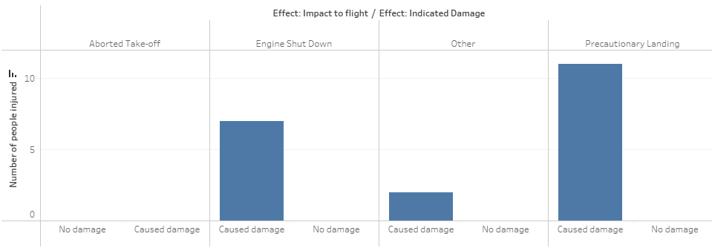
This analysis will identify the types of incidents (e.g., engine shutdown, precautionary landing) that are most likely to result in injuries. By understanding these patterns, you can propose targeted prevention strategies, such as enhanced pilot training, improved wildlife detection systems, or stricter operational procedures during high-risk phases of flight.

Slide 8
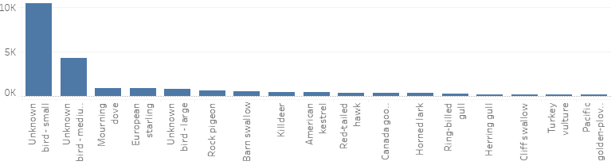
Frequent Species: The chart will reveal which species (e.g., gulls, geese) are most commonly
involved in strikes. Larger birds or flocking species may dominate the list.
Conservation Measures:
Habitat Management: Modify or remove habitats around airports that attract wildlife, such as wetlands or grasslands, to deter birds from settling near runways.
Wildlife Deterrents: Implement bird deterrents like sound cannons, falconry, or other scare tactics to reduce bird presence near flight paths.
Airport Infrastructure: Modify structures, such as installing bird netting or using reflective surfaces, to make airports less attractive to wildlife.
Airspace Monitoring: Use radar or drones to monitor wildlife activity near airports in real-time, allowing for preemptive action before strikes occur.

Slide 9
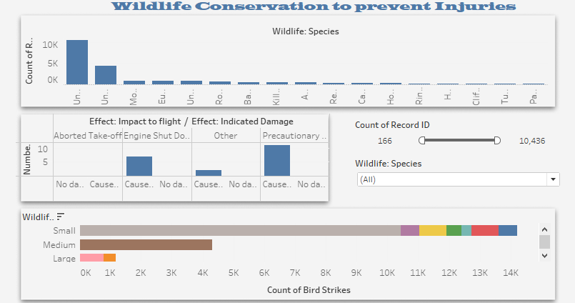

Slide 10
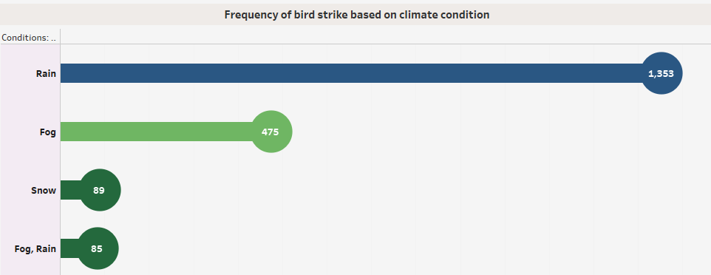
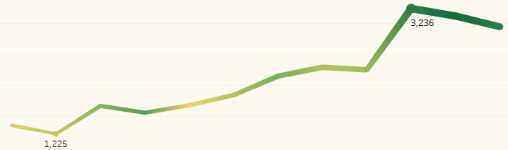
Rain is the most common weather condition during bird strikes, accounting for 1,353 incidents. This suggests that bird activity and flight operations may continue or increase in rainy conditions.
Fog: Fog is the second-most common condition, with 475 strikes. This indicates that reduced visibility due to fog can contribute to bird strike incidents.
when we come across day wise Saturday, Thursday, Tuesday and at time
of landing, cloudy conditions and Month wise like on an average June to
October the flights are facing More Strikes.

Slide 11
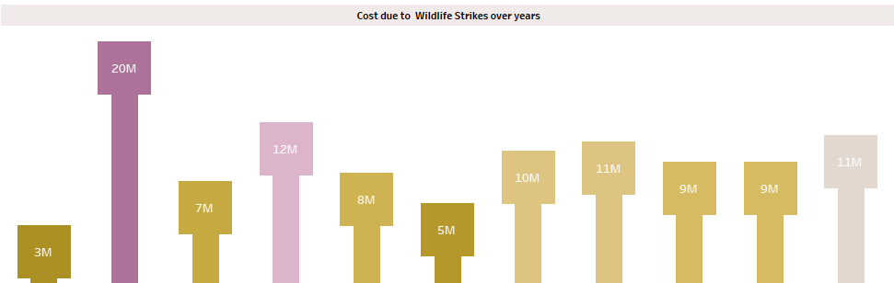
Business: This airline has incurred the highest total cost due to wildlife strikes, reaching 45 million dollars.
Major US Airlines: Several major US airlines, including United Airlines, Delta Air Lines, and FedEx Express, have also faced significant costs.
Regional Airlines: Smaller regional airlines like SkyWest Airlines and Air Midwest have incurred lower costs but still face financial impacts.
Increasing Trend: There appears to be a general upward trend in the total cost of wildlife strikes over the years, with a significant spike in 2001.
Fluctuations: While the overall trend is upward, there are fluctuations in specific years, indicating that the cost can vary depending on various factors.
Wildlife strikes can impose a substantial financial burden on airlines, particularly larger carriers.
Operational Disruptions: These strikes can lead to flight delays, cancellations, and aircraft damage.

Slide 12
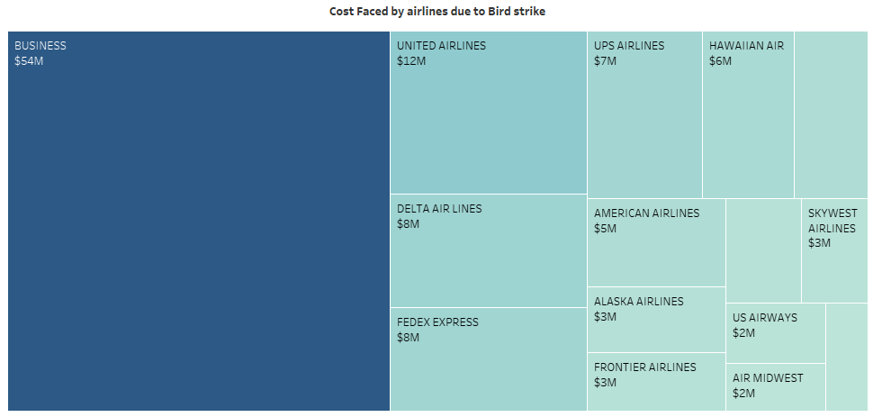

Slide 13
Key recommendations
Wildlife Habitat Management: Modify or remove wildlife habitats near airports and implement effective bird control techniques, such as visual and auditory deterrents, to reduce bird activity.
Safety Measures: Enhance pilot training and implement real-time airspace monitoring to preempt bird strikes.
Operational Adjustments: Focus mitigation efforts on high-risk phases of flight, aircraft types, and weather conditions to reduce the likelihood of incidents.

Slide 14
Conclusion
The analysis of bird strikes provides critical insights into the factors contributing to these incidents. Larger birds, such as geese and gulls, pose the highest risk, particularly during the takeoff and landing phases. Additionally, certain weather conditions, such as rain and fog, show a higher frequency of bird strikes. Airports in states like California, Texas, Florida, and New York experience the most incidents, indicating a need for targeted wildlife management in these areas.

